Slide 1

चरैवेति, चरैवेति
Keep progressing to attain a higher self.
avinash.bhagat@lpu.co.in Avinash Bhagat 9463281930

Slide 2
CAP275: Data Communication and Networking
Lecture # 2
Performance of Computer Network
avinash.bhagat@lpu.co.in Avinash Bhagat 9463281930

Slide 3
Computer Network
The term ''Computer Network'' is a collection of autonomous computers interconnected by a single technology.
Two computers are said to be interconnected if they are able to exchange/share information.
Notes:
The resources which can be shared are software, hardware, and data.

Slide 4
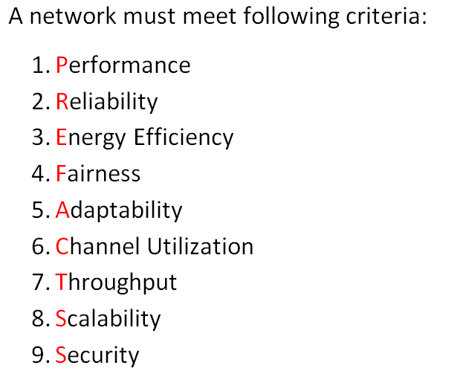
Computer Network
Notes:
Performance, Reliability, Energy Efficiency, Fairness, adaptability, channel utilization, throughput, scalability and security

Slide 5
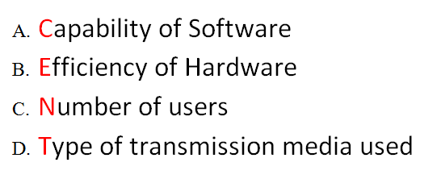
Performance
Performance can be measured in :
Transit Time
Response Time
Notes:
Performance, Reliability, Energy Efficiency, Fairness, adaptability, channel utilization, throughput, scalability and security
Performance of network depends upon.

Slide 6
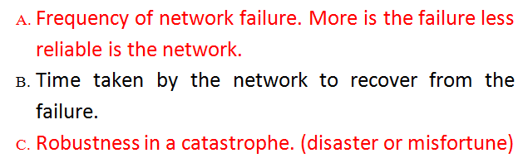
Reliability of Network
Notes:
Performance, Reliability, Energy Efficiency, Fairness, adaptability, channel utilization, throughput, scalability and security
Depends upon

Slide 7

Energy Efficiency:
Notes:
Performance, Reliability, Energy Efficiency, Fairness, adaptability, channel utilization, throughput, scalability and security
Depends upon

Slide 8

Fairness :
Notes:
Performance, Reliability, Energy Efficiency, Fairness, adaptability, channel utilization, throughput, scalability and security
Depends upon

Slide 9

Adaptability :
Notes:
Performance, Reliability, Energy Efficiency, Fairness, adaptability, channel utilization, throughput, scalability and security
Depends upon

Slide 10

Channel utilization :
Example :
A signal carries 4 bits in each signal unit, if 1000 signals are sent per second, find bit rate and baud rate.
Signal Unit: 4 bits
Baud Rate [Signal Units per second]: 1000 Bd (baud)
Bit Rate [Baud Rate * Signal Unit]: 4000 bps (bits per second)
Notes:
Performance, Reliability, Energy Efficiency, Fairness, adaptability, channel utilization, throughput, scalability and security
Depends upon
While network speed measures the transfer rate of data from a source system to a destination system, network bandwidth is the amount of data that can be transferred per second .
One would assume that high-bandwidth networks would be fast and provide excellent throughput. In reality this is not always the case-not when you throw latency into the mix.
Latency is the delay packets experience while moving through a network and typically is the culprit behind poor application response time and frustrated users.
And as the distance between two points grows, latency accumulates as well.

Slide 11

Throughput :
Notes:
Performance, Reliability, Energy Efficiency, Fairness, adaptability, channel utilization, throughput, scalability and security
Depends upon
Both frequency and bandwidth are the two major terms related to data transmission. The major difference between frequency and bandwidth is that frequency shows the number of complete cycles appearing in unit time. As against bandwidth is the overall amount of data transmitted in a unit time.

Slide 12
Scalability :

Slide 13
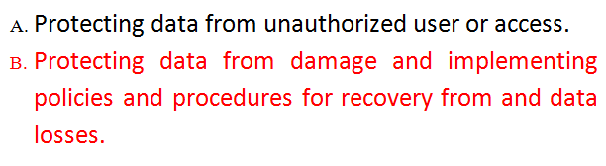
Security:
Notes:
Performance, Reliability, Energy Efficiency, Fairness, adaptability, channel utilization, throughput, scalability and security

Slide 14
Subjective Questions
Question:
Define Computer Network. What are certain criteria that a computer network should meet?
[10 marks]

Slide 15
Multiple Choice Questions
Frequency of failure and network recovery time after a failure are measures of the _______ of a network.
a. Performance
b. Reliability
c. Security
d. Feasibility
An unauthorized user is a network _______ issue.
a. Performance
b. Reliability
c. Security
d. All the above

Slide 16
Multiple Choice Questions
Frequency of failure and network recovery time after a failure are measures of the _______ of a network.
a. Performance
b. Reliability
c. Security
d. Feasibility
An unauthorized user is a network _______ issue.
a. Performance
b. Reliability
c. Security
d. Feasibility

Slide 17
Multiple Choice Questions
Performance is often evaluated by which of the following networking metric
a. Delay
b. Throughput
c. both a and b are correct
d. none of the above is correct
The performance of a network depends on :
  a. the number of users
  b. the type of transmission medium,
c. the capabilities of the connected hardware and software
d. All of the above are correct

Slide 18
Multiple Choice Questions
Performance is often evaluated by which of the following networking metric
a. Delay
b. Throughput
c. both a and b are correct
d. none of the above is correct
The performance of a network depends on :
  a. the number of users
  b. the type of transmission medium,
c. the capabilities of the connected hardware and software
d. All of the above

Slide 19
References :
Text Book:
  Behrouz A. Forouzan, Data Communication and networking, 4th Ed., Tata McGraw Hills year of publication 2006
Other Specific Book:
  Andrew S. Tanenbaum,Computer Network 2nd Edition, PHI, Third Edition 1997
  Comer E. Doughlas,Computer Networks and Internets, 2nd Ed., Pearson, 2000
  W. Stallings,Data and Computer Communications, 7th Ed., Pearson, 2002.

Slide 20

See you in next class

